Slide 1
Medical Cost Analysis

Slide 2
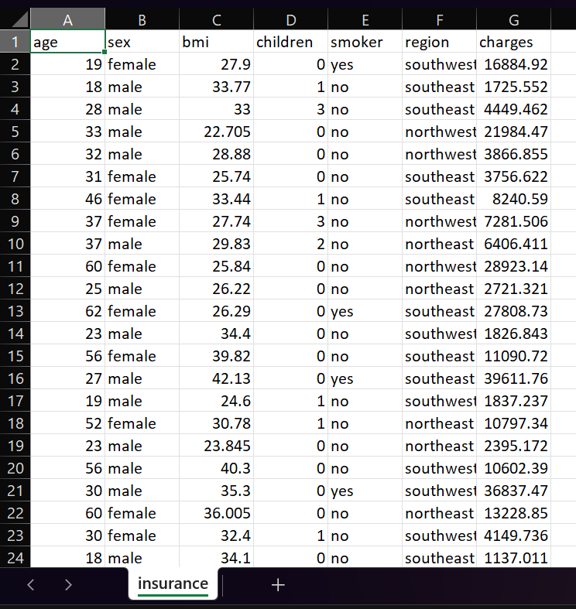
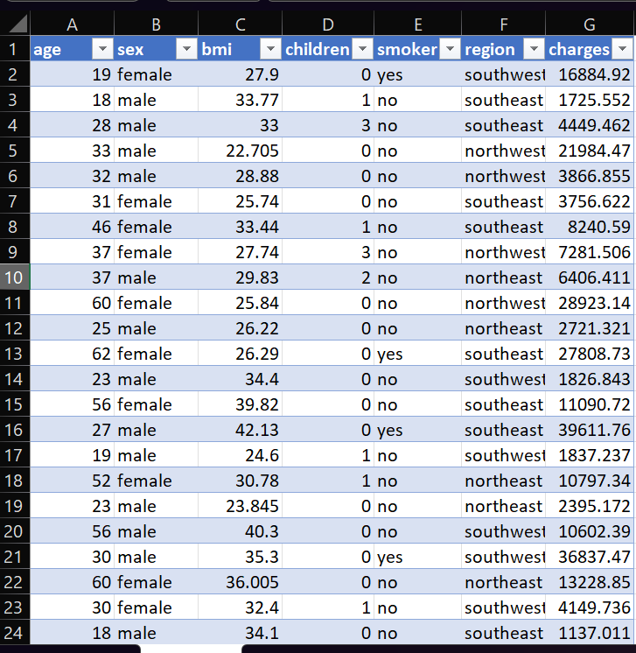
Dataset Overview Raw Dataset & Structured Table View
Full dataset (columns visible)
Table view (formatted Excel table)
The dataset contains medical insurance details of individuals • It includes demographic and health-related attributes • Key variables: age, BMI, smoking status, region, and charges • The data is used to analyze factors affecting medical costs

Slide 3
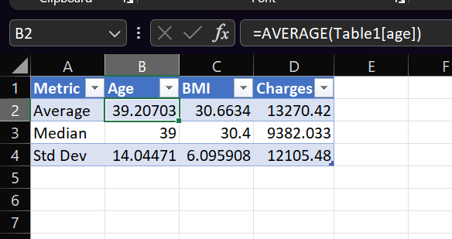
1. Basic Statistics and Data Understanding
• The average medical charges indicate overall cost trends
• The median values help understand the central distribution
• Standard deviation shows variation in data
• Charges have high variation compared to age and BMI

Slide 4
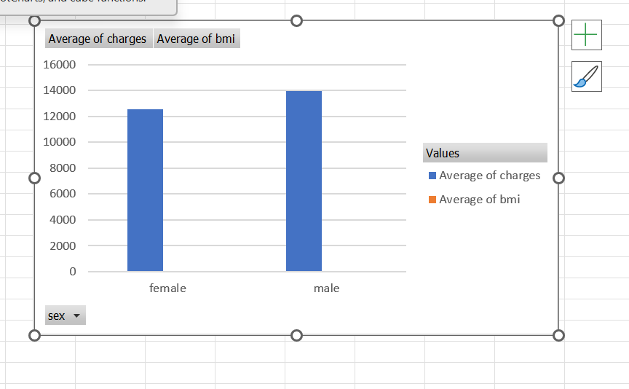
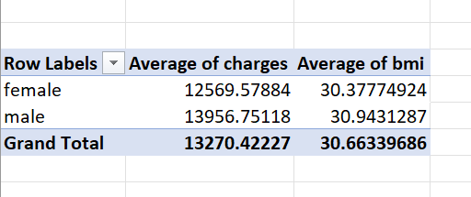
Gender Wise Medical Cost Analysis
• The analysis compares medical costs between male and female beneficiaries
• Average charges vary slightly between genders
• BMI differences are minimal between male and female
• Gender alone is not a strong factor affecting medical costs

Slide 5
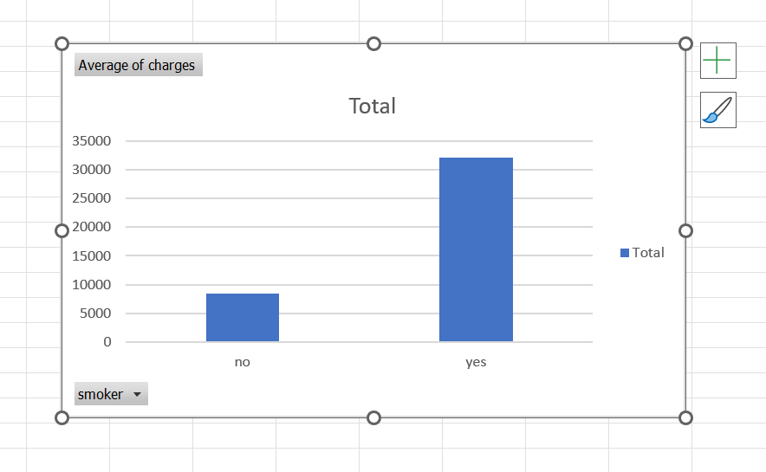
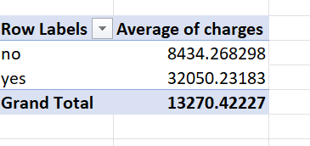
Impact of Smoking on Medical Costs
• Smoking has a significant impact on medical costs
• Smokers have much higher average charges compared to non-smokers
• This indicates higher health risks associated with smoking
• Smoking is one of the strongest factors affecting medical expenses

Slide 6
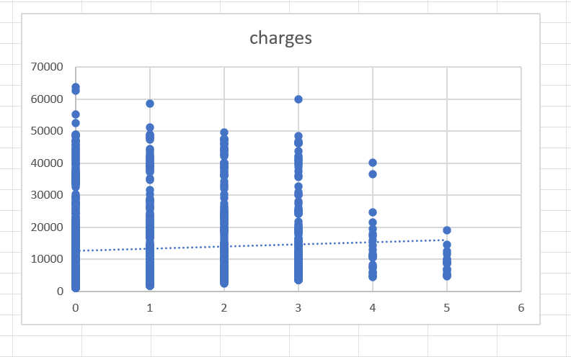
DEPENDENTS ANALYSIS
• This analysis examines the relationship between number of dependents and medical charges
• The scatter plot shows no clear pattern between the variables
• Correlation value indicates a weak relationship
• Number of dependents does not significantly affect medical costs

Slide 7
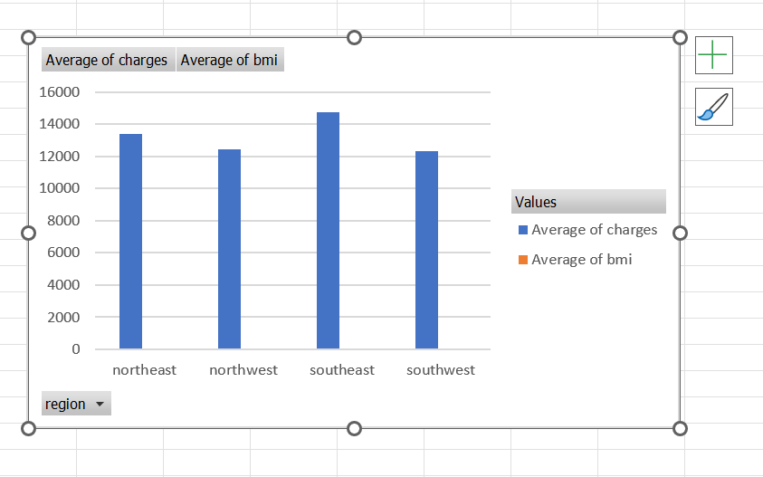
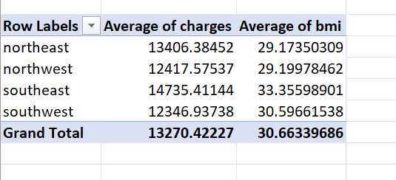
Region Wise Medical Cost Analysis
• This analysis compares medical costs across different regions
• Certain regions show higher average medical charges
• BMI also varies slightly across regions
• Regional factors may influence healthcare costs

Slide 8
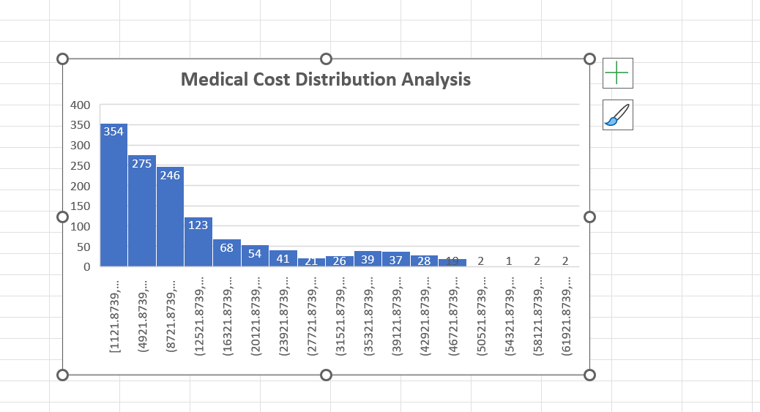
Medical Cost Distribution Analysis
• The histogram shows the distribution of medical charges
• Most individuals fall into lower cost ranges
• A smaller number of individuals have very high medical expenses
• This indicates a right-skewed distribution of costs

Slide 9
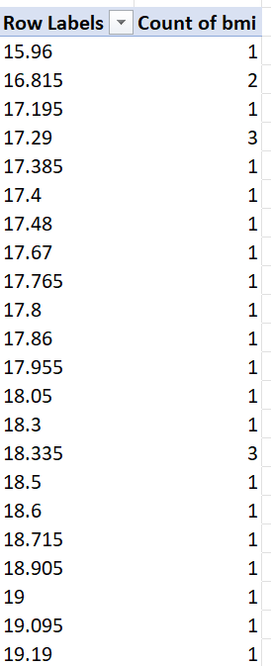
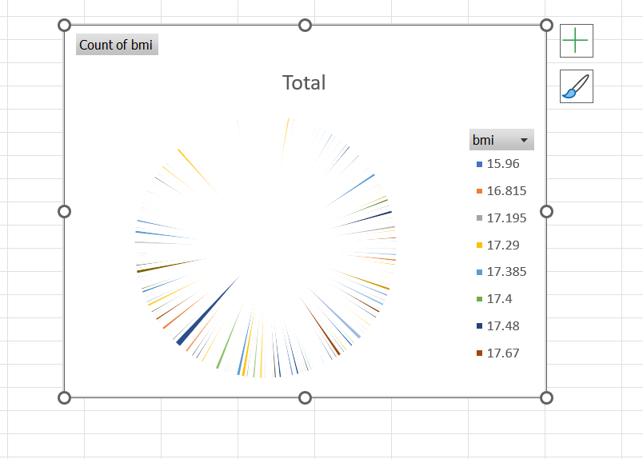
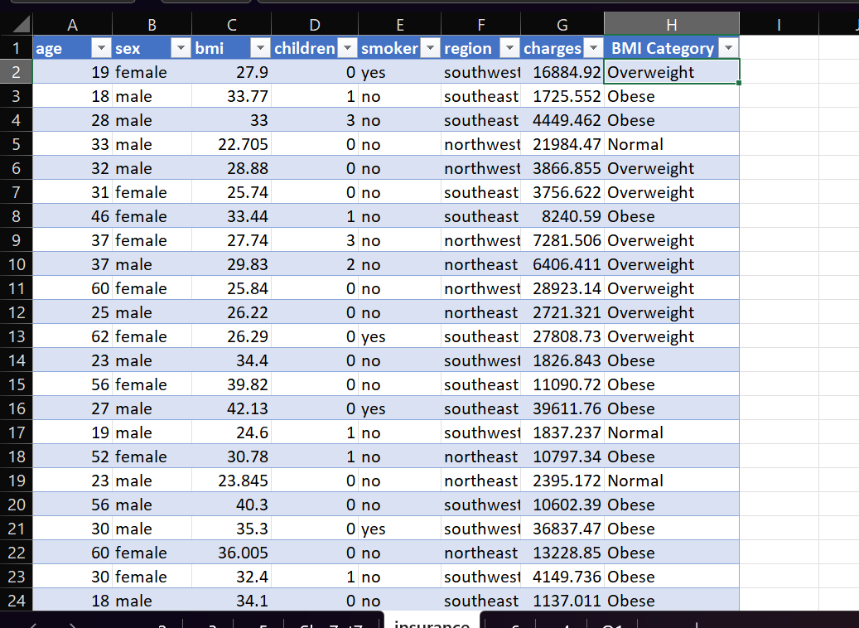
BMI Category Analysis
• Individuals are categorized based on BMI values
• Most individuals fall into overweight and obese categories
• Fewer individuals are in the normal or underweight category
• Higher BMI levels may contribute to increased medical costs

Slide 10
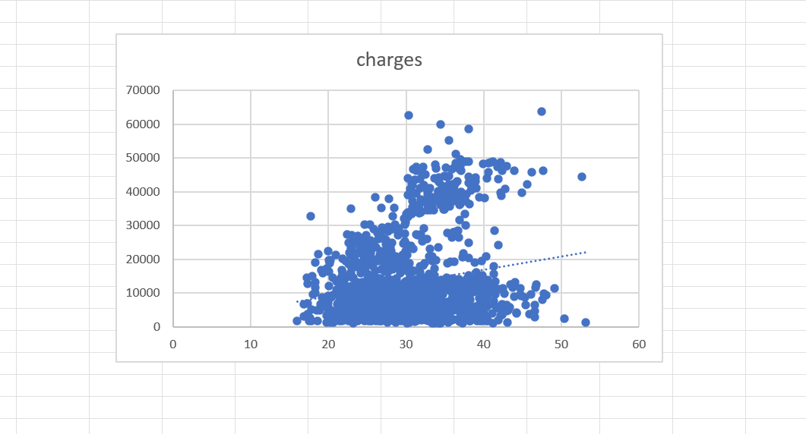

BMI vs Medical Cost Analysis
• This analysis examines the relationship between BMI and medical charges
• The scatter plot shows a positive trend between BMI and costs
• Higher BMI is generally associated with higher medical expenses
• BMI is an important factor influencing healthcare costs

Slide 11
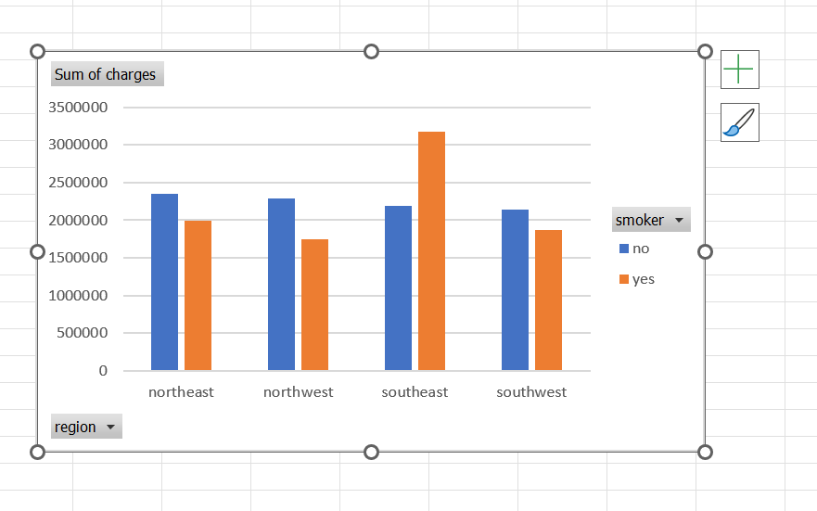
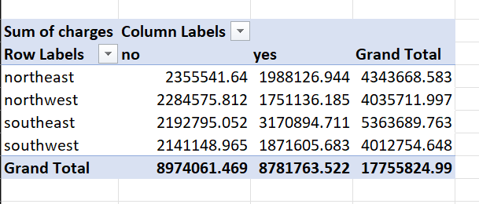
Smoking and Region Impact on Medical Costs
• This analysis examines the combined effect of smoking and region on medical costs
• Smokers consistently have higher charges across all regions
• Certain regions show significantly higher costs for smokers
• This indicates both smoking and location influence healthcare expenses

Slide 12
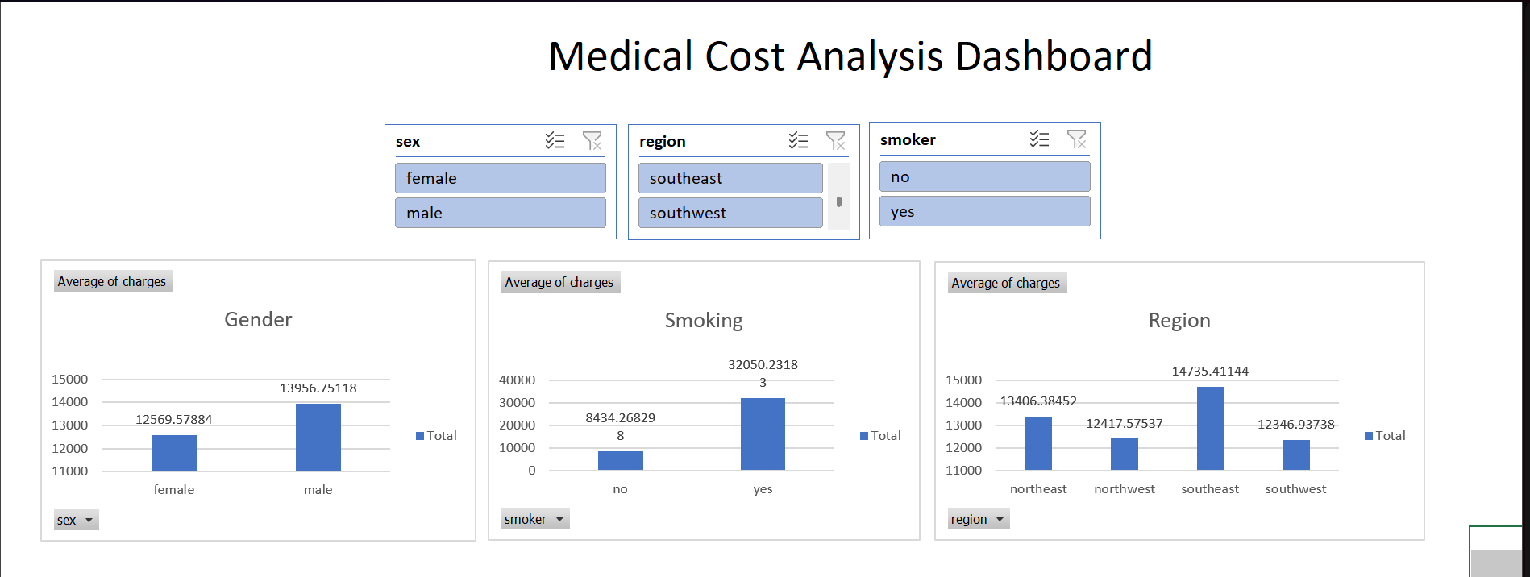
Interactive Dashboard
• The dashboard provides an interactive view of medical cost data
• Slicers are used to filter data by gender, smoking status, region, and BMI category
• Users can dynamically explore insights by applying filters
• This enhances decision-making and data understanding

Slide 13
Youtube link:-
https://youtu.be/c5xXnE1uDPY?si=8VHXGVHBpmReQCq2

